Slide 1
Office 365 Development
July 2014

Slide 2
Course Agenda
Introduction to Office 365 Development
Module 1: Deep Dive Apps for Office in Outlook
Module 2: Deep Dive Apps for Office in Word
Module 3: Deep Dive Apps for Office in PowerPoint
Module 4: Deep Dive Apps for Office in Excel
Module 5: Deep Dive into SharePoint Hosted Apps
Module 6: Deep Dive into Provider Hosted Apps
Module 7: Deep Dive into Security and OAuth
Module 8: App Lifecycle Management

Slide 3
Deep Dive into Provider Hosted Apps
Speaker
Speaker

Slide 4

Agenda
Introduction
Programming in C#
Programming in JavaScript
Chrome Control
Remote Event Receivers

Slide 5
Introduction

Slide 6

Cloud Architecture
SQL Azure
Azure Web Sites
Remote Web
Azure Data Market
Host Web
SharePoint Online
App Web¹
¹App Web presence is dependent upon
whether or not artifacts like lists are deployed
Notes:
Remote web is deployed on separate infrastructure
Typically this is Azure web sites, but can be anything
Solution may or may not have an App Web depending upon whether anything is deployed (like lists or libraries in the App Web)
Host web can be accessed by remote web using OAuth or cross-domain library
Additional assets like SQL Azure or web-based REST services can be accessed from the remote web and incorporated into the solution

Slide 7
On Premises Architecture
SQL Databases
Internet Information Server
Remote Web
Web Services
Host Web
SharePoint 2013
App Web¹
¹App Web presence is dependent upon
whether or not artifacts like lists are deployed
Notes:
Remote web is deployed on separate infrastructure
Typically this is IIS, but can be anything
Solution may or may not have an App Web depending upon whether anything is deployed (like lists or libraries in the App Web)
Host web can be accessed by remote web using Server-to-Server High Trust or cross-domain library
Additional assets like SQL databases or web services can be accessed from the remote web and incorporated into the solution

Slide 8
App Permissions
Remote web always has full rights to app web
App permissions are the lesser of user and app permissions to the given resource
Provider-hosted app can utilize “app-only” permissions to “elevate” privileges.

Slide 9
App-Only Permissions
Considers app permissions only, ignores user
Set AllowAppOnlyPolicy to true in AppManifest
Get an app-only token
Notes:
Provider-hosted apps can use “app only” permissions
Update the App manifest to indicate this is OK
Then you need an app-only token in code

Slide 10
Creating Provider-Hosted Apps
Web Project
ASP.NET Web Forms
MVC 5
Authorization
Azure Access Control Services
Server-to-Server High Trust
Programmability
SharePointContextProvider class
Managed CSOM or REST
JavaScript Cross-Domain Library
Notes:
Visual Studio supports both ASP.NET Web Forms and MVC5
On-premises authorization uses S2S
Cloud authorization uses OAuth
The SharePointContextProvider simplifies token management
Managed CSOm and RESt can be used directly from the server side
The cross-domain library can be used from JavaScript

Slide 11
demo
Creating a Provider-Hosted App

Slide 12
Programming in C#

Slide 13
SharePointContextProvider Class
Checks for valid Context Token
Redirects if it does not exist
Simplifies the management of context
Provides an ACS or STS context
Context exposes properties for key values like Host Web URL
Simplifies the management of tokens
Context exposes methods to retrieve tokens
Notes:
The SharePointContextProvider simplifies the management of context, and tokens
It uses a cookie to store the CacheKey, and stores the actual token in session state on the server referenced by the cache key
All of this improves performance and makes programming easier

Slide 14
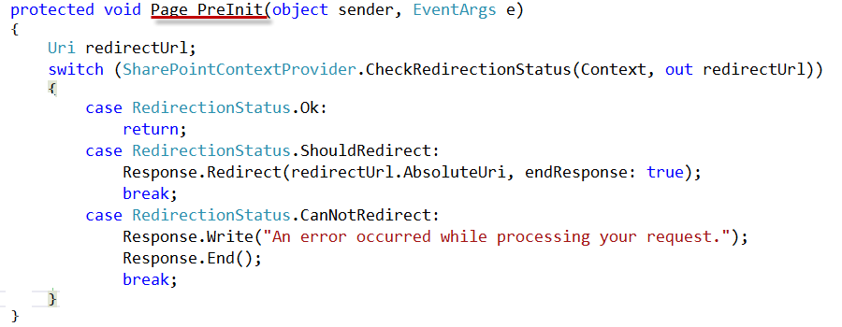
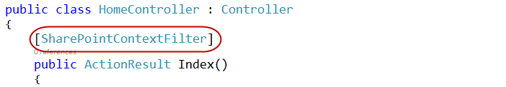
Validating Context Token
Web Forms
MVC 5
Notes:
ASP.NET Web Forms uses the PreInit method to validate the Context Token
Notice how it will redirect if the token is not valid
ASP.NET MVC 5 uses a filter to run essentially the same code
Notice how the filter attribute is applied to the controller

Slide 15
Managing SharePoint Context
SharePointContextProvider GetSharePointContext
Returns SharePointAcsContext in cloud
Returns SharePointHighTrustContext on premises
Properties
SPAppWebUrl
SPClientTag
SPHostUrl
SPLanguage
SPProductNumber
Notes:
SharePointAcsContext and SharePointHightTrustContext both inherit from SharePointContext
This means that the same code works in both cloud and on-premises environments

Slide 16
Managing Security Tokens
CSOM
CreateAppOnlyClientContextForSPAppWeb
CreateAppOnlyClientContextForSPHost
CreateUserClientContextForSPAppWeb
CreateUserClientContextForSPHost
REST
AppOnlyAccessTokenForSPAppWeb
AppOnlyAccessTokenForSPHost
UserAccessTokenForSPAppWeb
UserAccessTokenForSPHost
Notes:
The SharePointContext makes it easy to get the tokens you need

Slide 17
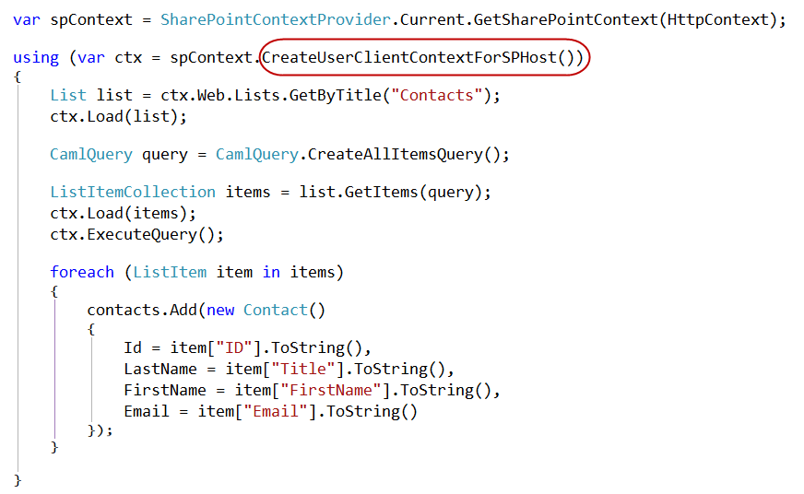
Managed CSOM

Slide 18
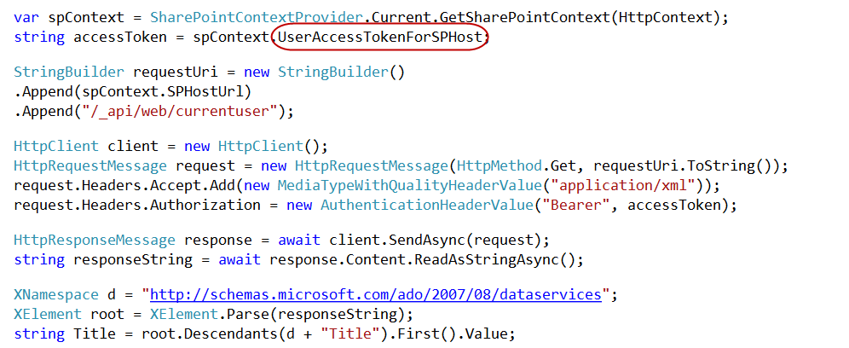
Managed REST

Slide 19
demo
C# Code in a Provider-Hosted App

Slide 20
Programming in JavaScript

Slide 21
Managing SharePoint Context
SPContext.js Library part of project template
Appends SPHostUrl as query string to all the links which point to current domain
Notes:
This is an optional component
You could also use HTML5 to build your own cache
But you really need to save the standard tokens because you will need them on other pages in the app
That’s the basic problem: you need the standard tokens in many places, so you can cache them or pass them along

Slide 22
Cross Domain Library
Same-domain policy prevents JavaScript from making direct calls to either the app web or host web from the remote web
Required to make JavaScript calls to both the app web and host web
Notes:
Makes it possible to call the app web or host web from JavaScript in the remote web

Slide 23
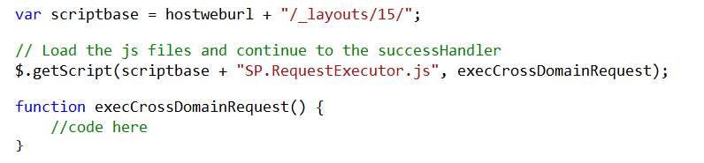
Loading the Cross-Domain Library
SP.RequestExecutor.js located in LAYOUTS directory
Option 1: Copy and include directly in your app
Option 2: Load Dynamically using jQuery

Slide 24
Cross-Domain Library Architecture
Web Page
IFRAME
App Web
AppWebProxy.aspx
SP.RequestExecutor.js
AppWebProxy.aspx
Remote Web
SharePoint
Notes:
The remote web loads the SPRequestExecutor.js library
The remote web create a new SP.RequestExecutor object, initializing it with the URL of the app web
This causes a hidden IFRAME to be created, which loads APPWebProxy.aspx from the LAYOUTS directory
The SP.RequestExecutor object uses the HTML5 postmessage command to send requests from the remote web
The request is executed by the AppWebProxy.aspx page
The response is returned

Slide 25
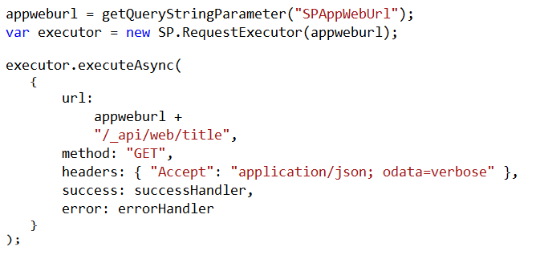
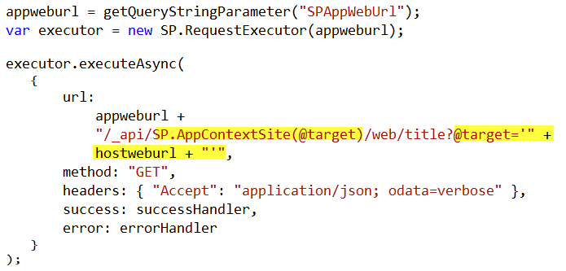
Cross-Domain REST Calls
Call targeting App Web
Call targeting Host Web
Notes:
When calling the host web, you must switch the context

Slide 26
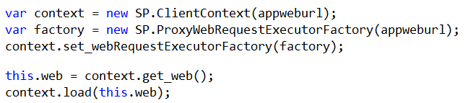
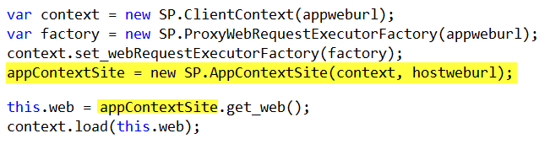
Cross-Domain CSOM Calls
Call targeting App Web
Call targeting Host Web
Notes:
When calling the host web, you must switch the context

Slide 27
demo
The Cross-Domain Library

Slide 28
The Chrome Control

Slide 29
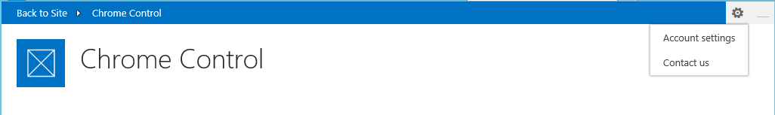
Chrome Control
JavaScript Component for creating basic banner and navigation elements
Notes:
When you create a remote web, it’s nice to have it borrow some of the characteristics of the host web
This way, it doesn’t surprise the user by changing the UI drastically

Slide 30
Loading the Chrome Control
SP.UI.Controls.js located in LAYOUTS directory
Option 1: Copy and include directly in your app
Option 2: Load Dynamically using jQuery

Slide 31
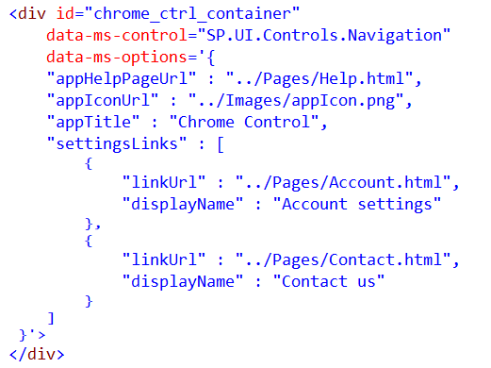
Chrome Control (Declaratively)
Notes:
Create a div tag
Use the attributes data-ms-control and data-ms-options
The chrome control will look for these attributes and render itself in this div

Slide 32
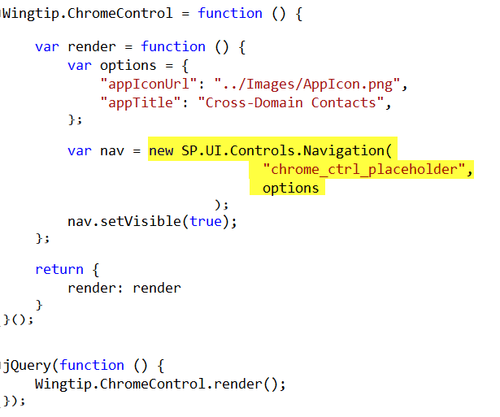
Chrome Control (Programmatically)
Notes:
Here a new chrome control is created in code
When created, it expects you to supply the options and the ID of the div where it should render
Then it renders itself in the div

Slide 33
demo
The Chrome Control

Slide 34
Remote Event Receivers

Slide 35
Remote Event Handlers
Event Handler code runs in remote web
Deployed as web service in remote web
Two-way events
“Before” events (a.k.a, “ING” events)
Synchronous call
Supports a return value
One-way events
“After” events (a.k.a, “ED” events)
Asynchronous call
No return value
Notes:
The event handler infrastructure follows the same pattern as the in-process handlers of old
We have both “before” and “after” event
These are also known as “ING” and “ED” events like “ItemAdding” and “ItemAdded”
Two-way events are synchronous

Slide 36
Supported Events
 | Site | List | List Schema | List Item | App
Create | X | X | X | X
Update |  |  | X | X
Delete | X | X | X | X
Move | X |  |  | X
Check-In |  |  |  | X
Uncheck-In |  |  |  | X
Check-out |  |  |  | X
Attachments |  |  |  | X
File Move/Convert |  |  |  | X
Install |  |  |  |  | X
Uninstall |  |  |  |  | X
Update |  |  |  |  | X

Slide 37
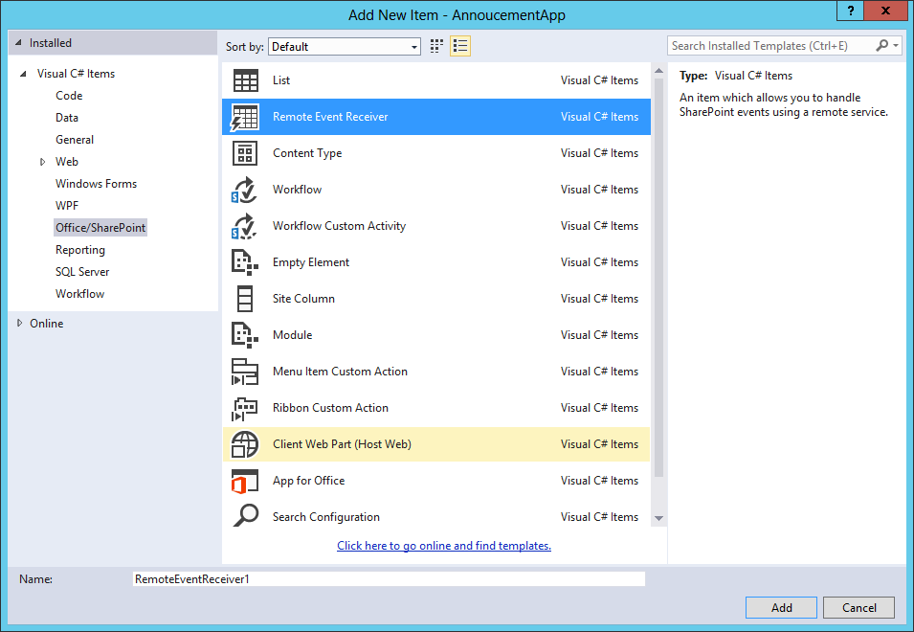
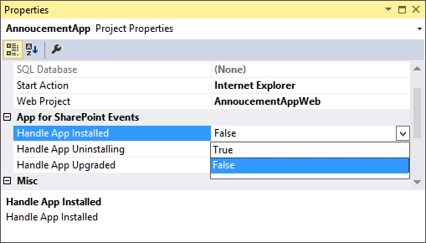
Adding a Remote Event Receiver
Use the “Add New” dialog
For Site, List, Item, and
Schema events
Use the “Properties” dialog
for App events

Slide 38
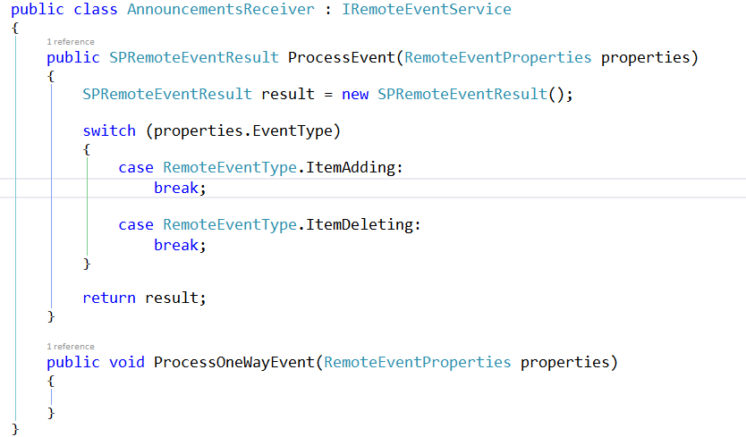
IRemoteEventService
Must be implemented by the remote web service

Slide 39
SPRemoteEventProperties
Passed to web service in response to event
Provides contextual information
Supports reading and updating user inputs
Allows for data validation

Slide 40
SPRemoteEventResult
Returns by two-way events
Allows events to be cancelled
Allows status to be returned

Slide 41
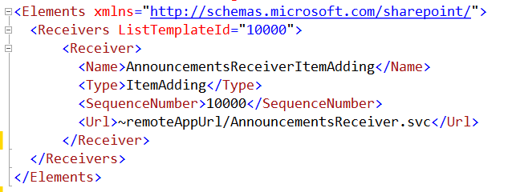
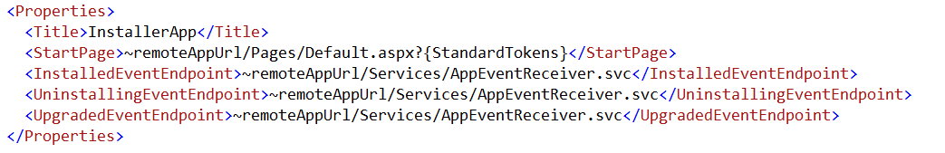
Registering Events Receivers
CAML Element for Lists, Items, Sites, Schema events
App Manifest for
App events

Slide 42
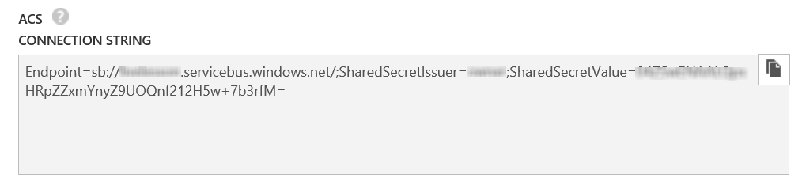
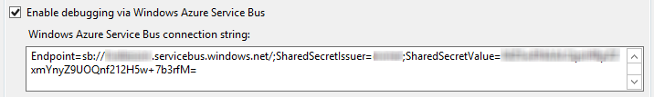
Debugging Considerations
Remote Event Receivers require Azure Service Bus to support debugging
Create a Service Bus Namespace
Copy the Connection String into the SharePoint Project Properties

Slide 43
demo
Remote Event Receivers

Slide 44
Summary
Introduction
Programming in C#
Programming in JavaScript
Chrome Control
Remote Event Receivers

Slide 45

© 2012 Microsoft Corporation. All rights reserved. Microsoft, Windows, and other product names are or may be registered trademarks and/or trademarks in the U.S. and/or other countries.
The information herein is for informational purposes only and represents the current view of Microsoft Corporation as of the date of this presentation. Because Microsoft must respond to changing market conditions, it should not be interpreted to be a commitment on the part of Microsoft, and Microsoft cannot guarantee the accuracy of any information provided after the date of this presentation. MICROSOFT MAKES NO WARRANTIES, EXPRESS, IMPLIED OR STATUTORY, AS TO THE INFORMATION IN THIS PRESENTATION.

